Slide 1

APPLIED MACHINE LEARNING

Slide 2


Predictive Modeling for Credit Risk Assessment

Slide 3

GROUP-6
Vinay Thamatam
Bhanu Sree Ramaiahgari
Karan Raturi
Neelima Nandigam

Slide 4

INTRODUCTION
Revolutionizing Credit Risk Assessment
Hey there! We're diving into an exciting project focused on creating a super-smart predictive model to evaluate credit risk. Through the magic of machine learning, our goal is to predict how creditworthy applicants are based on their personal data and past credit records. This project isn't just about numbers; it's about using technology to make better decisions and reduce risks in the lending world. By blending data science with financial know-how, we're on a mission to shake up the traditional credit assessment process and bring in more accurate and efficient ways to evaluate credit. Join us on this journey to transform the future of credit evaluations!

Slide 5

What Business need ???? "The objective of the project is to build a BEST model WITH MAXIMUM ACCURACY that predicts whether an individual is eligible for Credit Card Approval or not."

Slide 6
OVERVIEW
● Banking / Financial Institutes plays a significant role in providing financial service.
● To maintain the integrity, bank/institute must be careful when investing in customers to avoid financial loss.
● Before giving credit to borrowers, the bank must come to about the potential of customers.
● The term credit scoring, determines the relation between defaulters and loan characteristics. rewrite

Slide 7

APPROACH DESIGN
Applying models
Comparing the applied models
Evaluation of models
Analyze the best model
Preparation of data

Slide 8

Datasets overview

Slide 9

Contains personal information such as age, income, employment status, etc., of loan applicants.
APPLICATION_RECORD

Slide 10

CREDIT_RECORD
This file MAINLY records various credit-related behaviors including past credit records, every month’s balance and Status.

Slide 11
DATASETS
Application
ID
Credit
ID
AMT_INCOME_TOTAL
DAYS_EMPLOYED
DOB
WORK_PHONE
FAM_MEMBERS
MONTHS_BALANCE
OCCUPATION
OWN_HOUSE
OWN_CAR
STATUS

Slide 12

Exploratory DATA ANALYSIS

Slide 13

Relationships and SINGLE-variable plots

Slide 14
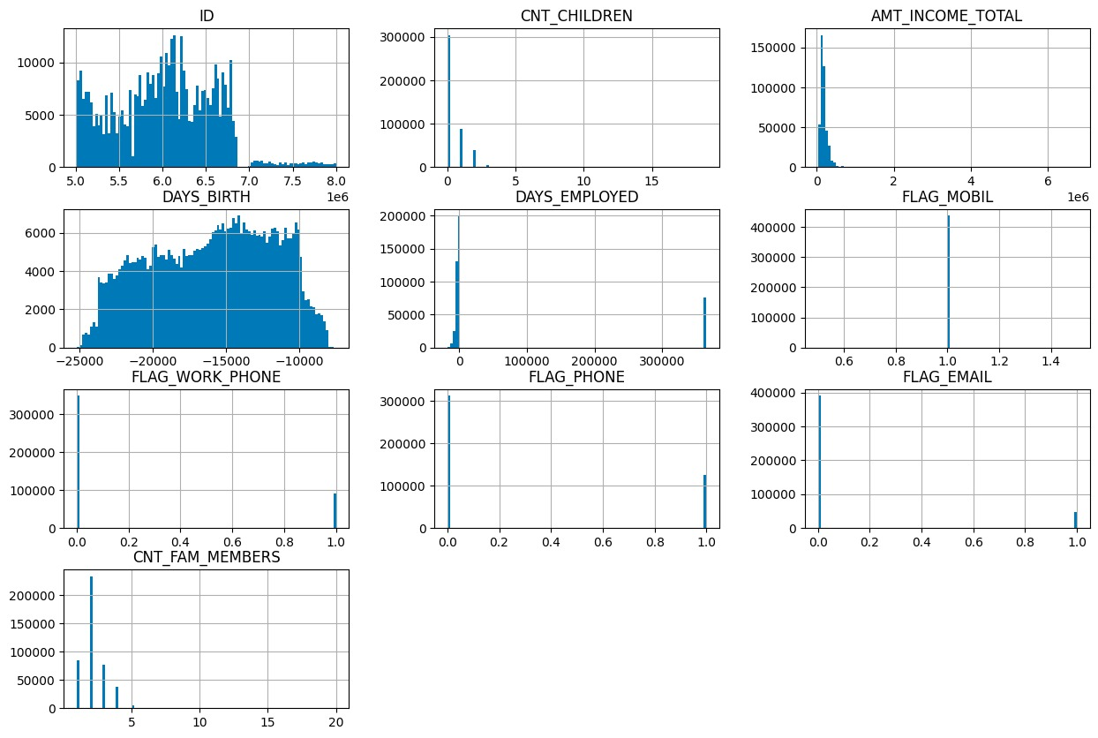
Visualizations

Slide 15
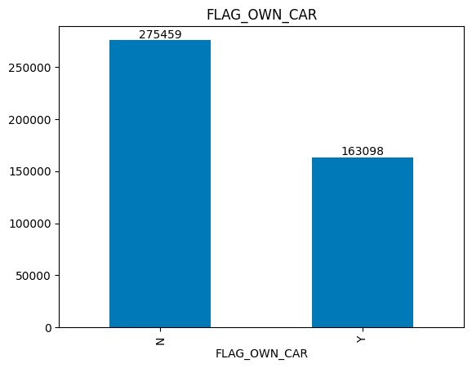
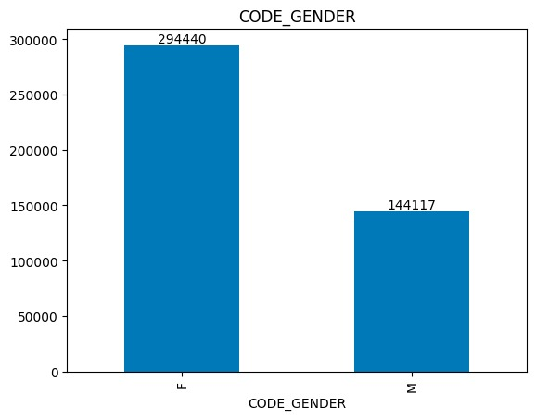
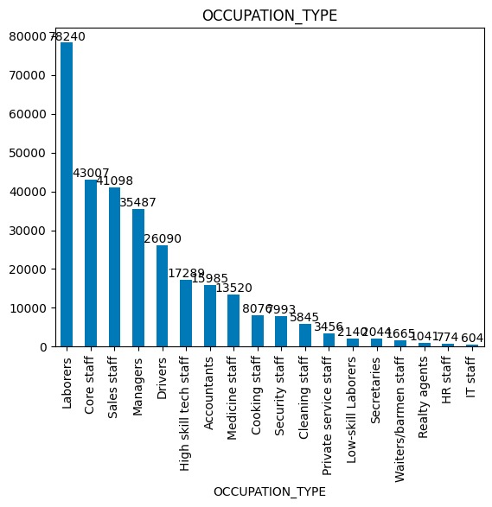
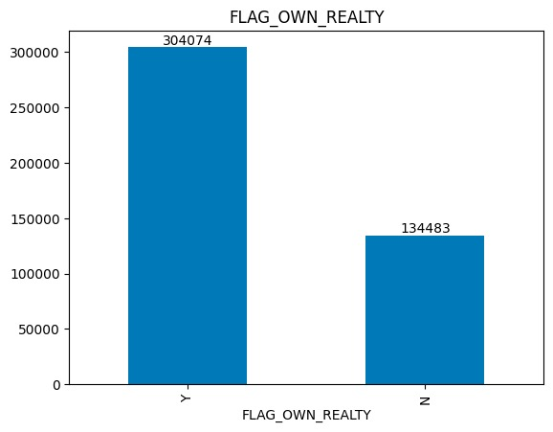
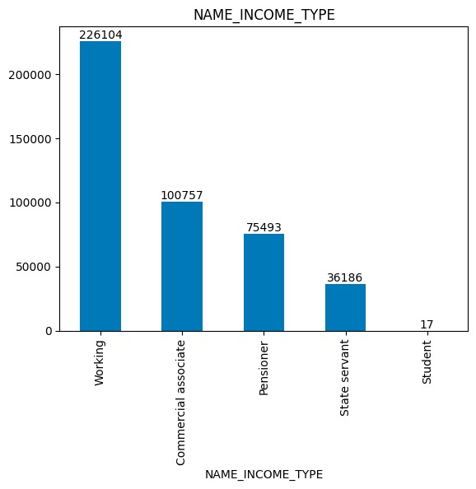
Visualizations

Slide 16
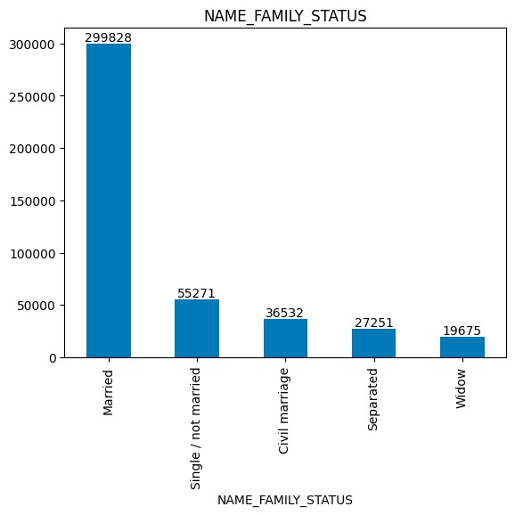
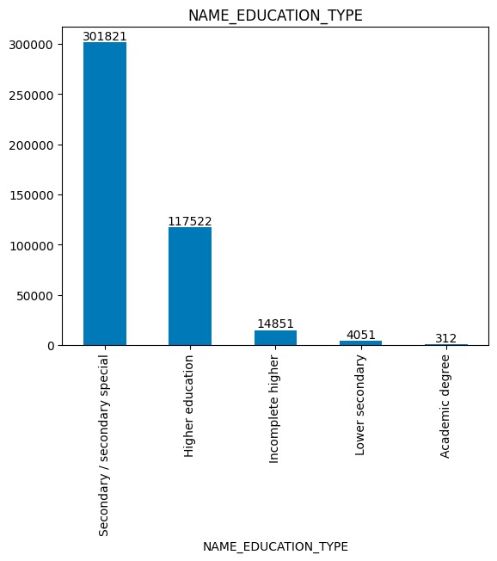
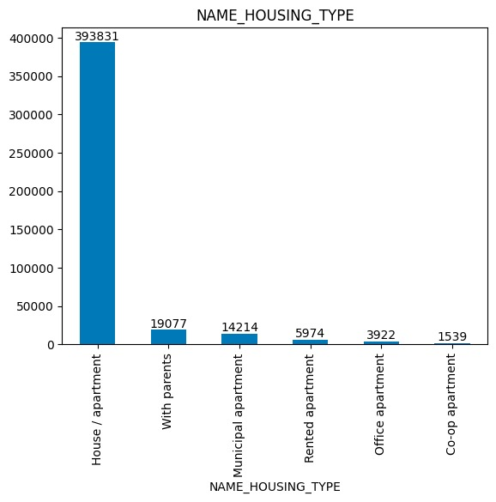
Visualizations

Slide 17
Relationships and MULTI-variable plots

Slide 18
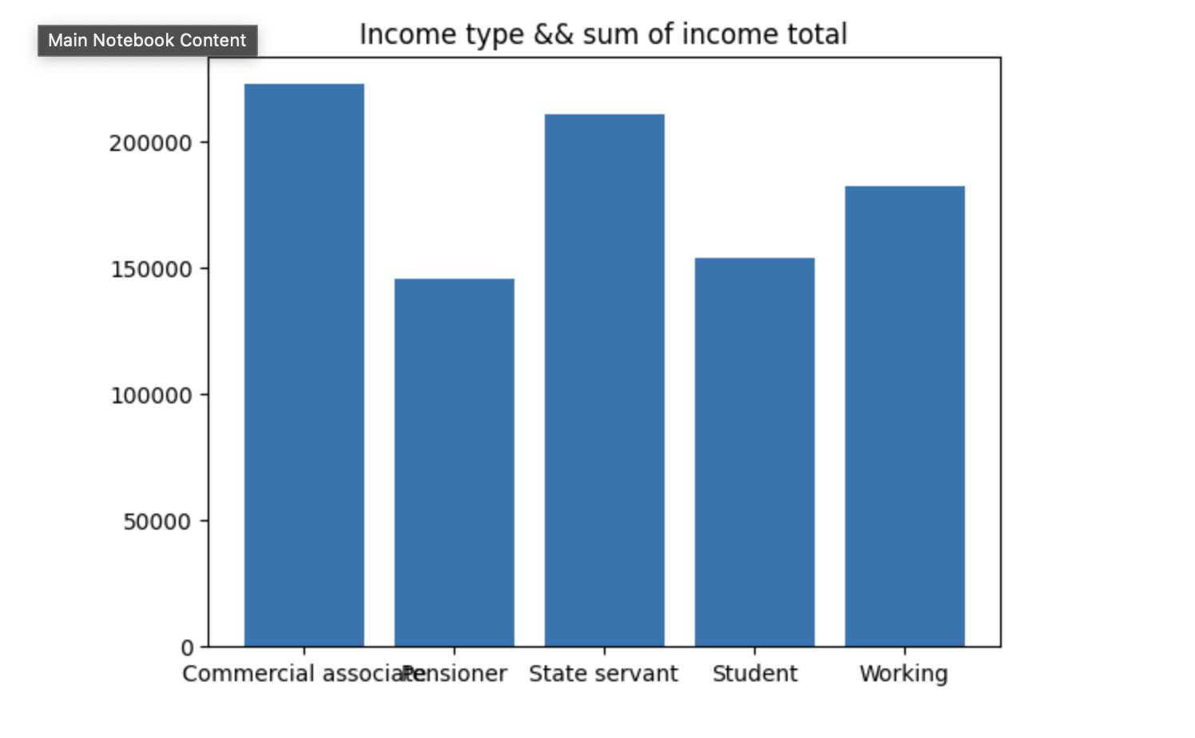
Visualizations

Slide 19
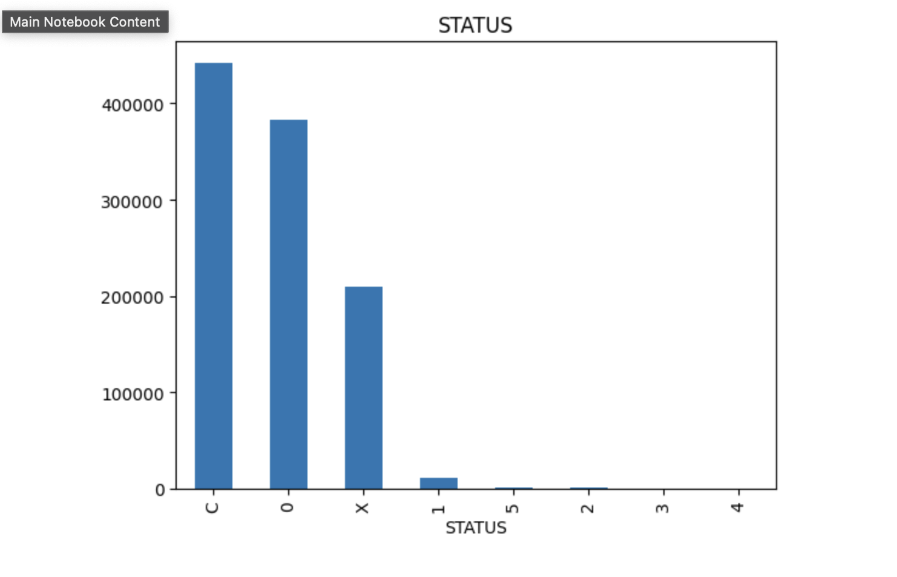
Visualizations

Slide 20

Modeling approach for credit risk assessment involves….

Slide 21

DATA PREPROCESSING -DATA CLEANING -FEATURE ENGINEERING -NORMALIZATION/ SCALING

Slide 22

FEATURE ENGINEERING

Slide 23

Feature selection creation of derived features handling categorial data addressing missing data

Slide 24

DATA SPLITTING
TRAINING
DATA
annotated text, images, video or audio
TESTING
DATA
used to evaluate a performance of the built model

Slide 25

CLASSIFICATION MODELS
Logistic Regression
Random Forest Classifier
Decision Tree Classifier
Support Vector Machines

Slide 26


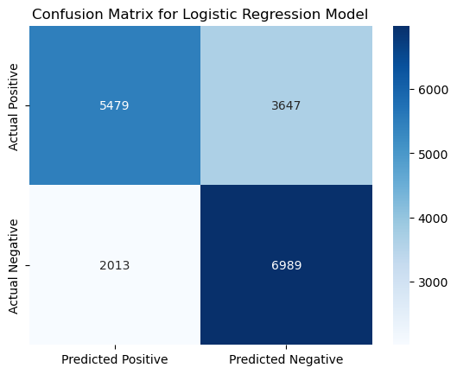
LOGISTIC REGRESSION
Logistic regression is a widely used classification algorithm in machine learning, especially for binary classification problems where the target variable has two possible outcomes. Here's an overview of logistic regression in classification models.
Binary Logistic Regression
Accuracy : 67.8%
Precision : 65.7%
Recall : 77.6%

Slide 27
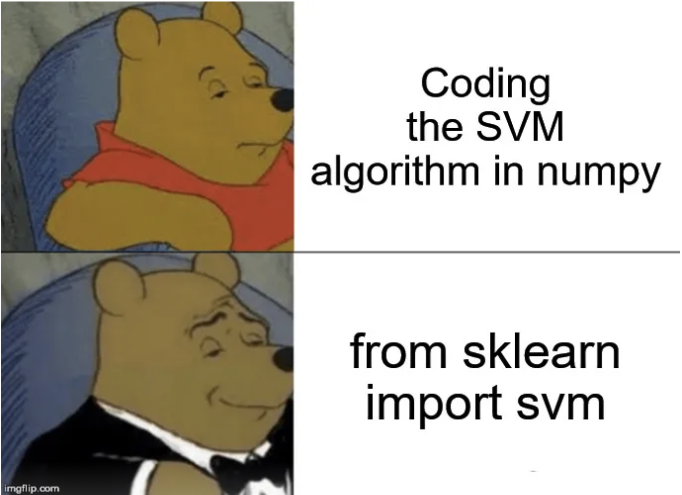
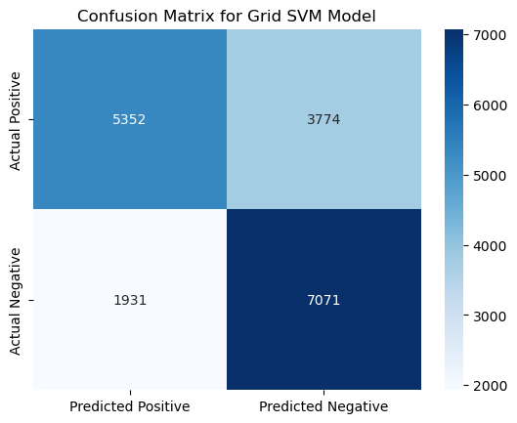
Linear SVM
Hard SVM:
Hard Margin SVM aims to find the maximum-margin hyperplane that separates the classes with no misclassifications, assuming that the data is linearly separable. It is not robust to outliers and requires strict separation without any errors.
Soft SVM:
Soft Margin SVM introduces slack variables to allow for misclassifications and violations of the margin. It aims to find a hyperplane that maximizes the margin while penalizing misclassifications and margin violations. Soft SVM provides a balance between margin maximization and error minimization, offering more robustness in handling noisy data.
Here we used grid search to account for different margins.
Accuracy: 68.5%
Precision: 65.2%
Recall: 78.5%

Slide 28

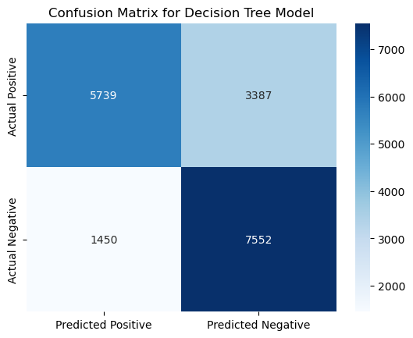
DECISION TREES
A Decision Tree in machine learning is a supervised learning algorithm that consists of a tree-like structure where nodes represent features, branches represent decision rules, and leaf nodes represent outcomes. The algorithm makes decisions by recursively splitting the data based on feature attributes, aiming to create subsets that are as pure as possible in terms of the target variable. Decision Trees are interpretable models that excel at capturing complex relationships between features and the target variable, making them valuable for both classification and regression tasks.
Accuracy: 73.3%
Precision: 69%
Recall: 83.9%

Slide 29
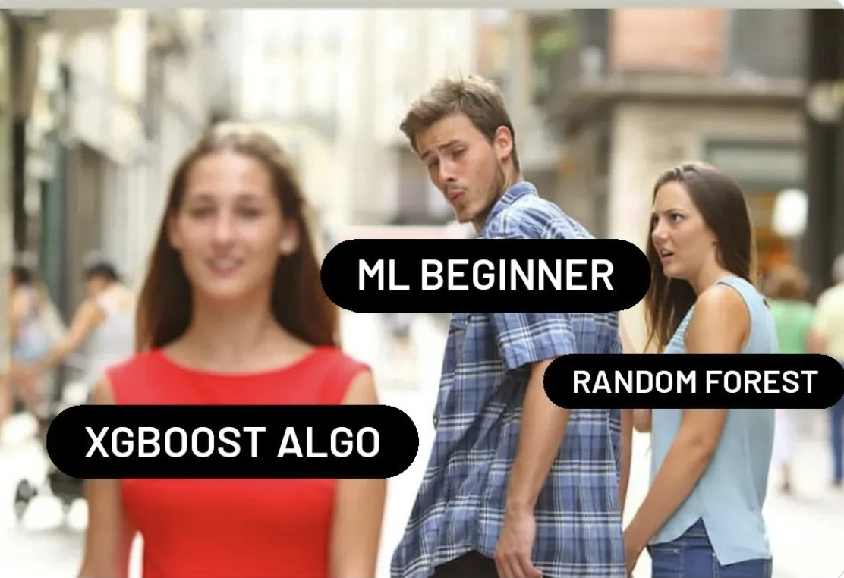
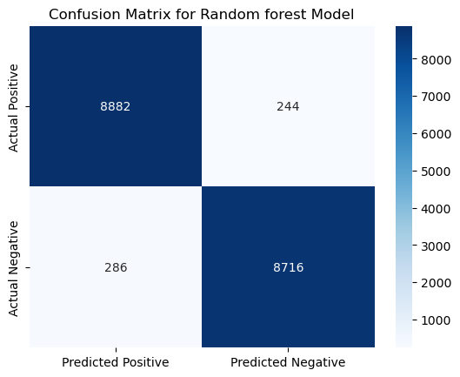
RANDOM FORESTS
The Random Forest Classifier in machine learning is an ensemble learning method that constructs multiple decision trees and combines their predictions to improve accuracy and robustness in classifying data. It is widely used for classification tasks and is known for its ability to handle high-dimensional data and provide insights into feature importance.
Accuracy: 97%
Precision: 97.3%
Recall: 96.9%

Slide 30

CONCLUSION
In conclusion, with a remarkable accuracy of 97%, the Random Forest algorithm outperformed Logistic Regression, Support Vector Machines, and Decision Trees for predicting credit card approval outcomes. Therefore, we've chosen Random Forest as our model of choice, poised to enhance credit evaluation accuracy and streamline the approval process for financial institutions.

Slide 31

Thank you

